Slide 1

Computer Programming
CS 103
Özyeğin University
School of Engineering
Fall 2018
Naveed ul Mustafa & Kubra Kalkan
naveed.mustafa@ozyegin.edu.tr
Kubra.kalkan@ozyegin.edu.tr

Slide 2


About this course
Learning objectives:
  Understand the basic concepts of
  computer programing
  Acquire a problem solving perspective
  with computational thinking
  Develop computer programs to solve
  (engineering) problems

Slide 3

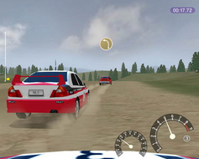
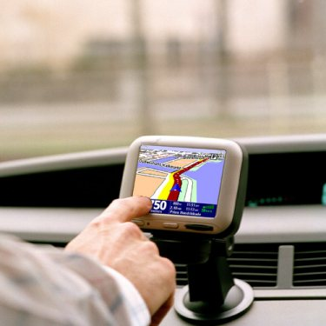
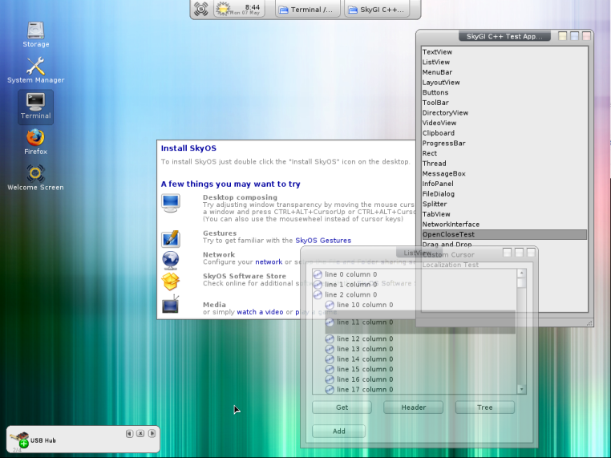
Computer Programs
(Software)
In daily life..

Slide 4

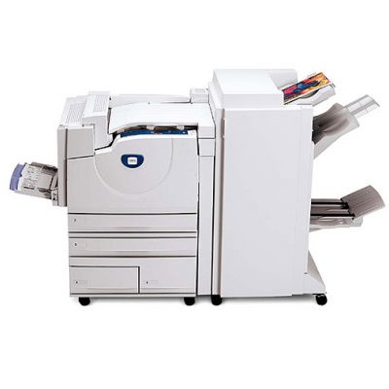
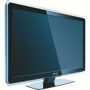
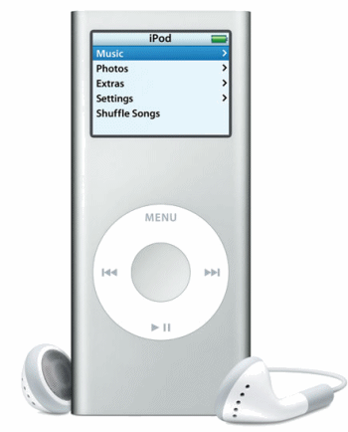
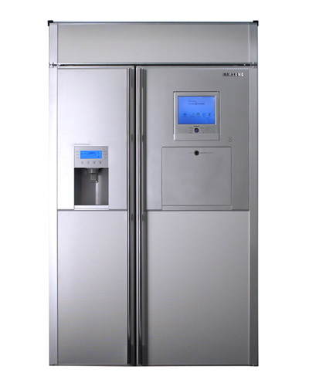
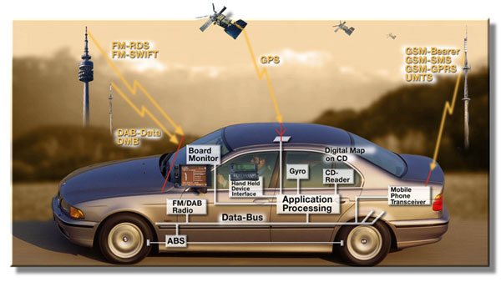
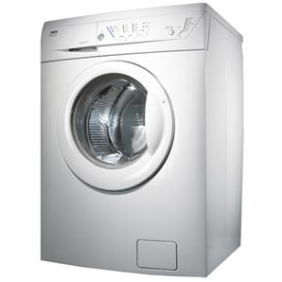

Software Everywhere!

Slide 5
Relationship between algorithms and programming
PROBLEM
-What are the steps to SOLVE this problem? ALGORITHM
-What is the tool?
PROGRAMMING LANGUAGES

Slide 6
Algorithms
Much of computer science involves the study of algorithms.
  A procedure/strategy for solving a problem.
  Derived from the name of the Persian mathematician al-Khwarizmi, who wrote the book Kitab al jabr w’al-muqabala.

Slide 7
Algorithms
To meet its more formal definition, an algorithm must be:
  Clearly and unambiguously defined.
  Effective, in the sense that its steps are executable.
    Bad: “multiply r by the exact value of π”.
  Finite, in the sense that it terminates after a bounded number of steps.
There may be more than one algorithm to solve a problem.
  Complexity of the algorithm plays a crucial role in which one to use.

Slide 8
A simple algorithm for presentation
Start
Slide visible?
No
Control the projector
Control the computer

Slide 9
A simple algorithm for presentation
Start
Slide visible?
Yes
Present the content
No
questions?
Control the projector
Yes
Control the computer
Answer the question

Slide 10
A simple algorithm for presentation
Start
Switch to the next slide
Slide visible?
Yes
Present the content
No
No
questions?
No
Last slide?
Control the projector
Yes
Yes
Control the computer
Answer the question
End

Slide 11
Algorithm as a simple program
01. REPEAT until the last slide
02. IF slide is visible
03. Present the content
04. ELSE
05. Control the projector
06. Control the computer
07. RETURN TO step #02
08. REPEAT for each question
09. Answer the question
10. SWITCH to next slide

Slide 12
Algorithm as a simple program
01. REPEAT until the last slide
02. IF slide is visible
03. Present the content
04. ELSE
05. Control the projector
06. Control the computer
07. RETURN TO step #02
08. REPEAT for each question
09. Answer the question
10. SWITCH to next slide
similar to keywords of a programming language
Numbered lines of code
A line of code in the program

Slide 13

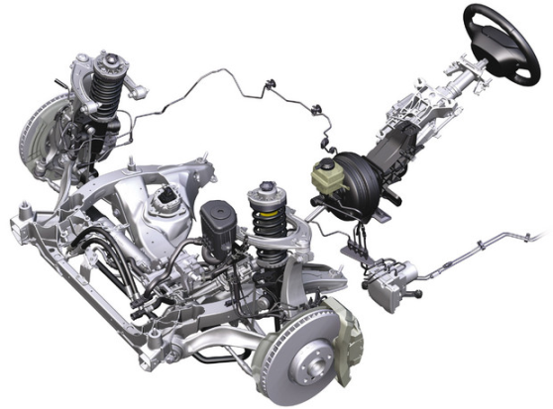
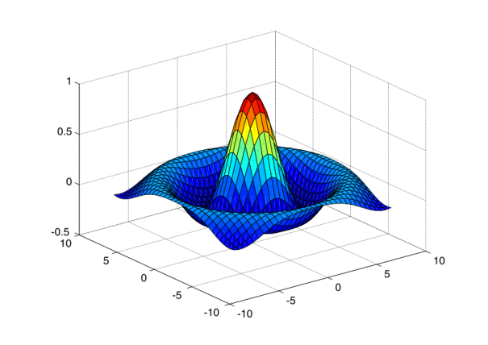
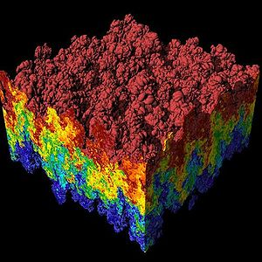
Computer programs for solving engineering problems, e.g.,
  EE: Implement signal processing algorithms for cellular networks
  IE: Implement optimization algorithms for scheduling and routing
  ME: Implement simulations to estimate energy consumption
  CS: Implement efficient, large-scale programs
  CE: Implement finite-element models to estimate life-time of materials.

Slide 14


Programming languages
We focus on the Java programming language
in this course

Slide 15
Java and others
Java is a popular programming language, but
  Java is just ‘a’ programming language
  In the future, you need to be able to grasp any other programming language (e.g., C/C++) quickly
The main goal is learning:
  underlying principles
  basic building blocks of
  all programming languages
  NOT specifically Java

Slide 16

Course Organization

Slide 17
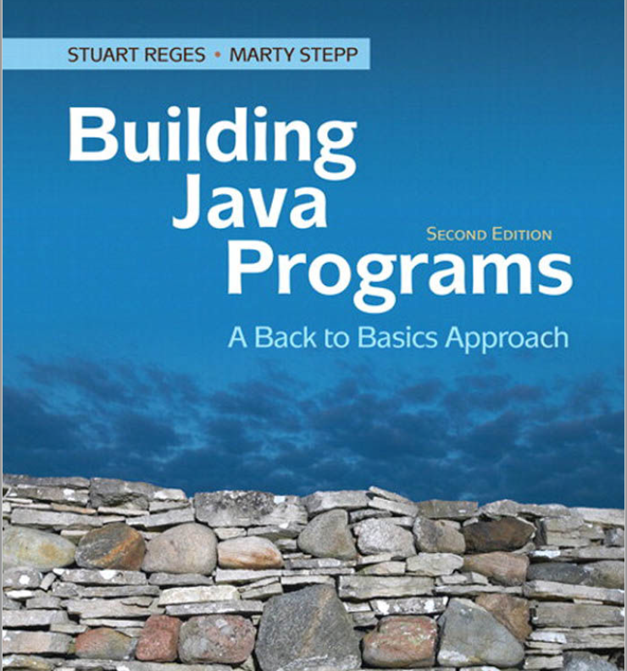
Study Material
Course book by
Stuart Reges and Marty Stepp,
Addison Wesley
Building Java Programs: A Back to Basics Approach
Assignments and announcements on LMS
  http://lms.ozyegin.edu.tr

Slide 18
Course Topics
Expressions (variables, declarations)
Statements (conditions, loops)
Methods
Characters and strings
Arrays
Random generator
File Operations
Searching & Sorting
Recursion

Slide 19
Class structure
2-hour lecture
  Section B: Thursday 10:40-12:30, 1st Faculty Building (EF) 2nd Floor Room 241
  Section C: Monday 8:40 to 10:30 , 1st Faculty Building (EF) 2nd Floor Room 237
2-hour practice – lab sections
  Section B: Friday 8:40-10:30, 1st Faculty Building (EF) 2nd Floor Room 241
  Section C: Tuesday 14:40 to 16:30 , 1st Faculty Building (EF) 2nd Floor Room 237
  Bring your own laptop
  Do the exercises given by the instructor

Slide 20
Assessment
1 midterm (has a weight of 0.35)
1 final exam (has a weight of 0.40)
Quizzes in class (has a weight of 0.25)
  There will be at least 5 quizzes.
Labs in class (has a weight of 0.00)
At least 6 assignments (not graded)

Slide 21
Make-up Rule
For the midterm, we have only one make-up exam if you have medical report showing your disability.
Make-up of makeup is strictly impossible.

Slide 22
To pass the course
Your letter grade will be determined by using a curve.
Fail if you get less than 30 points in final exam.
Overall grade > 50, pass ☺
Overall grade <40, fail ☹
Overall grade between 40 and 50, will be determined according to curve ?? 😐

Slide 23

Exceptions
Average of midterm exam, weighted quiz grades and labs < 25% => no final exam
You will fail (F) if
  you have less than 30 points in final exam
  you collect less than 40% of the overall points.
    A score above 40% does not guarantee a passing grade (D or above)
You may request a regrade on any graded item within 1 week

Slide 24
Grading Policy
Exams are closed book and closed notes. The weights for the exams are as follows:
    35 % (Midterm),
    25 % (Announced Quizzes)
    0% (Labs)
    40 % (Final exam).
Students are not allowed to take the final exam if the average of their midterm, weighted quiz and lab grades is less than 25 points.

Slide 25
Grading Policy Cont.
Quiz: 30 %
There will be questions about the given assignments in midterm or/and final exams.
Therefore, doing your assignment is useful :D

Slide 26
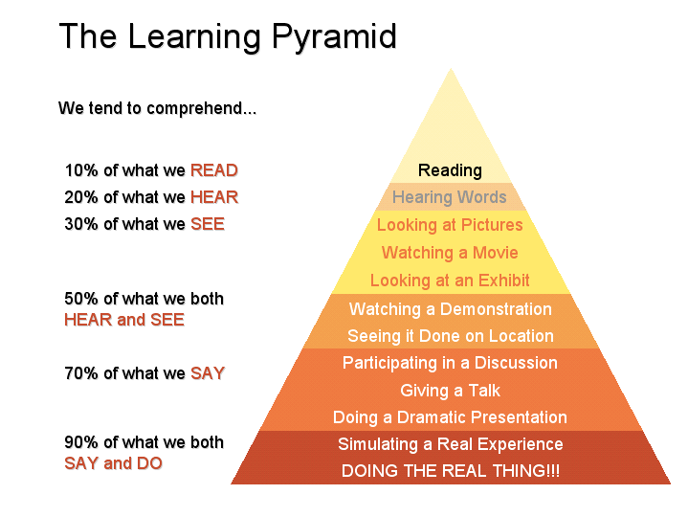
Learning..

Slide 27

Advices
Programming is a new topic for almost everyone
  Do not panic when confused
If in trouble, communicate as soon as possible
  Not after the midterm exam!
Write code, write code, write code !!!
Form study groups and learn from each other

Slide 28

Questions so far..

Slide 29
Final remark
You are encouraged to study with your friends, but
Quizzes and exams must be carried out individually
You should not look at the code of somebody else!
Zero tolerance policy
Read Academic Integrity Policy on the Course Web Site

Slide 30
LMS
https://lms.ozyegin.edu.tr
Please bring your laptops next Thursday !
We will install JDK, Eclipse

